Slide 1


Energy Optimization Using Machine Learning
Welcome! This presentation explores the transformative role of machine learning (ML) in energy optimization. As the energy sector evolves, efficiency, cost reduction, and sustainability become paramount. We'll delve into how ML models predict consumption patterns, enhance grid stability, and minimize energy losses, paving the way for a more sustainable and efficient energy future.
This presentation is structured to provide a clear understanding of how various machine learning models can be applied to address key challenges in energy optimization. We'll start by highlighting the importance of energy optimization and then dive into specific ML models and their performance.
Anany Shailan 229310172
Om Satyam Panda 229310076

Slide 2





Importance of Energy Optimization
Cost Reduction
Energy optimization reduces operational costs and eliminates energy waste, leading to significant savings.
Grid Stability
Optimized energy systems enhance grid stability and ensure reliable energy distribution.
Renewable Energy
Efficient energy usage supports seamless integration of renewable energy sources.
Environmental Impact
Minimizing energy consumption reduces the carbon footprint and promotes environmental sustainability.
By implementing effective energy optimization strategies, organizations can not only reduce their carbon footprint but also achieve substantial cost savings. The integration of renewable energy sources becomes more viable with optimized energy consumption.

Slide 3

Role of Machine Learning
Predict Demand
ML algorithms accurately predict energy demand and supply fluctuations.
Detect Inefficiencies
ML models identify inefficiencies and detect operational faults in real-time.
Assess Stability
Machine learning facilitates real-time grid stability assessment, crucial for reliability.
Optimize Storage
ML optimizes energy storage and distribution, enhancing overall efficiency.
Machine learning offers unparalleled capabilities in analyzing complex energy systems, providing actionable insights for optimized performance. These models enhance decision-making and enable proactive adjustments to changing energy demands, fostering a more resilient and efficient energy infrastructure.

Slide 4




Machine Learning Models Evaluated
Random Forest
Extra Trees
XGBoost
An ensemble learning method suitable for complex data.
A variant of Random Forest, known for its efficiency.
Optimized gradient boosting algorithm, highly accurate.
LightGBM
Gradient boosting framework with efficient memory use.
We evaluated these models for their adaptability, efficiency, and effectiveness in handling energy-related datasets and optimization tasks. Each model brings unique strengths to the table, making them suitable for different aspects of energy management and prediction.

Slide 5
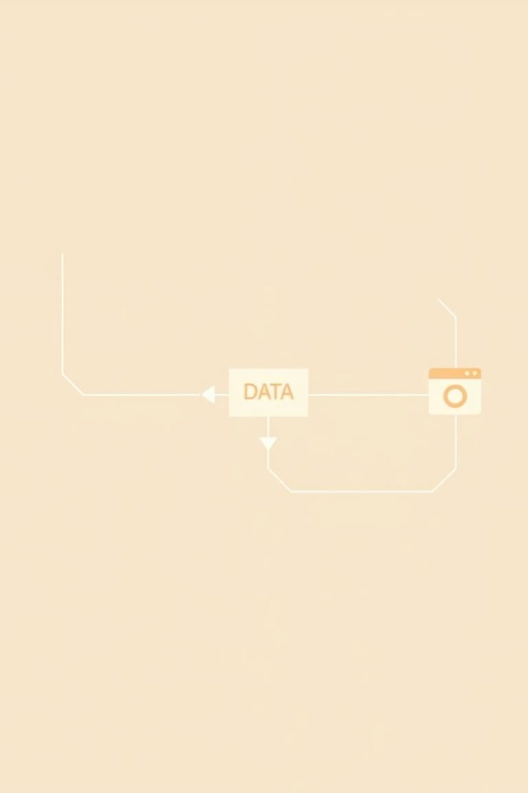
Implementation Workflow
1
Data Collection
Smart grid data and IoT sensors.
2
Preprocessing
Feature engineering and cleaning.
3
Model Training
Evaluation and selection.
4
Optimization
Real-time monitoring and adjustments.

Slide 6
Model Performance Comparison
Model
Regression (RMSE)
Classification (Accuracy)
Random Forest
0.0089
94.81%
Extra Trees
96.13%
XGBoost
0.0072
97.93%
LightGBM
0.0075
96.18%
CatBoost
0.0069
97.77%
The performance metrics highlight the effectiveness of different models in both regression and classification tasks. XGBoost stands out in classification with an impressive accuracy of 97.93%, while CatBoost excels in regression with a low RMSE of 0.0069. These results emphasize the importance of model selection based on specific performance requirements.

Slide 7
Best Performing Models
Regression
Classification
Time-Series
CatBoost Regression (0.0069 RMSE) offers precise energy consumption predictions.
XGBoost Classification (97.93% Accuracy) excels in anomaly detection and fault prediction.
LSTM is utilized for real-time analysis of energy demand and supply patterns.
CatBoost Regression provides unparalleled accuracy in predicting energy consumption, enabling proactive adjustments and efficient resource allocation. XGBoost Classification shines in identifying anomalies and predicting faults, ensuring minimal downtime and optimal performance. LSTM networks are critical for real-time analysis, allowing dynamic responses to changing energy demands and supply fluctuations.

Slide 8








Advantages of Models
Large Datasets
Mixed Features
Models efficiently handle extensive energy datasets.
Ability to process diverse data types for comprehensive analysis.
Interpretability
Reduces Overfitting
Insights into model decisions for improved understanding.
Robust techniques prevent overfitting for reliable predictions.
These advantages facilitate more accurate predictions, better fault detection, and real-time grid stability assessment in energy optimization. These capabilities enable energy professionals to make informed decisions, optimize resource allocation, and ensure the reliability of energy systems.

Slide 9




Future Trends
Deep Learning
Enables advanced energy forecasting and anomaly detection.
Reinforcement Learning
Supports dynamic energy management and grid optimization.
Edge AI & IoT
Facilitates real-time optimization and predictive maintenance.
The future of energy optimization lies in the continued advancement and integration of these cutting-edge technologies. Deep learning will refine forecasting accuracy, reinforcement learning will enable dynamic energy management, and edge AI with IoT will provide real-time optimization and predictive maintenance. Embracing these trends will drive the energy sector towards greater efficiency, sustainability, and resilience.

